Slide 1


Department of Collegiate and Technical Education
Introduction to Industrial Automation and Robotics (Week1)
Session 3 : Differentiate between SMD and SMT
Automation & Robotics( V Semester)
Electronics and Communication Engineering
Electronics and Communication Engineering – 20EC53I

Slide 2

Table of Content
What is SMT in electronics?
Process involved in SMT (surface mount technology) includes
What is SMD (surface mount device) in electronics?
Difference between SMT (Surface Mount Technology) and SMD (Surface mount devices)
Electronics and Communication Engineering – 20EC53I

Slide 3
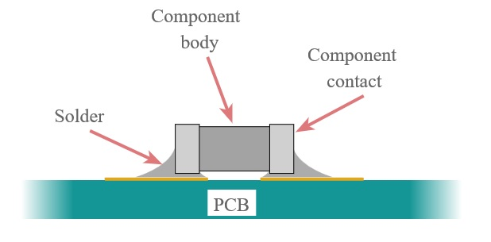
What is SMT in electronics?
Electronics and Communication Engineering – 20EC53I

Slide 4
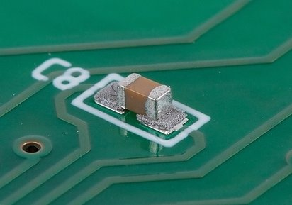
SMT (Surface Mount Technology) and SMD (Surface mount devices)

Slide 5
What is SMT in electronics?
Refers to the mounting process
SMT components are designed to be set down on a board and soldered to it.
Electronics and Communication Engineering – 20EC53I

Slide 6
Process involved in SMT (surface mount technology) includes
Printing: This involves applying a coat of solder paste onto the pads of the PCB.
Mounting: This refers to placing the surface mount components accurately onto the pads.
Reflow Soldering: This process involves melting the solder paste by passing the board and components through a hot oven.
Testing: The final process involves testing the boards through processes such as AOI which runs a number of quality checks on the boards such as component alignment and checking for solder bridges.
Electronics and Communication Engineering – 20EC53I

Slide 7
What is SMD (surface mount device) in electronics?
The components fitted onto PCBs
use pins that can be soldered directly onto the PCBs as opposed to using leads and wiring
With no holes to be drilled, they also make the process quicker and cost-effective
Electronics and Communication Engineering – 20EC53I

Slide 8
Difference between SMT and SMD
The primary difference between the two is that one refers to the mounting process while the other refers to the actual components.
Both are dependent on each other
Proper selection and arrangement of SMDs that is the primary process behind SMT.
SMDs determine the capacity of the board, SMT involves the installation of these components on the board.
SMT (surface mount technology) relates to the method used to place electronic components on a printed circuit board.
Electronics and Communication Engineering – 20EC53I

Slide 9
Assessment Questions
1. SMD means ?
(a) Surface mount devices.
(b) Side mount devices
(c) Surface map devices
(b) Side map devices.
Electronics and Communication Engineering – 20EC53I

Slide 10
Assessment Questions
2. SMT means ?
(a) Surface mount technology.
(b) Side mount technology.
(c) Surface map technology.
(b) Side map technology.
Electronics and Communication Engineering – 20EC53I

Slide 11
Assessment Questions
3. Process involved in SMT ?
(a) Testing
(b) Mounting
(c) Reflow Soldering
(d)All the above.
Electronics and Communication Engineering – 20EC53I

Slide 12
Assessment Questions
4. The applying a coat of solder paste onto the pads of the PCB is called?
(a Testing
(b) Mounting
(c) Reflow Soldering
(d) Printing
Electronics and Communication Engineering – 20EC53I

Slide 13
Assessment Questions
5. The process involves melting the solder paste by passing the board and components through a hot oven is called
(a Testing
(b) Mounting
(c) Reflow Soldering
(d) Printing
Electronics and Communication Engineering – 20EC53I

